Slide 1

ADO Assignment 2
Cheryl Neo Yuqian (S10241900K)
Ang Zhi Xin Jaden (S10242787D)
Ma Cheng Ze Ryan (S10242111C)
Tan Li Yan (S10246159C)
Lim Ee Swen Joie (S10242326C)
Ong Pei Qi (S10243724H)

Slide 2
Table of contents
01
02
03
04
05
Analysis & Insights
Project Overview
Product and Sprint Backlog + Burndown Chart
Last Sprint Retrospective
Individual Presentation
Notes:
Cheryl edited

Slide 3
01
Analysis/Insights

Slide 4
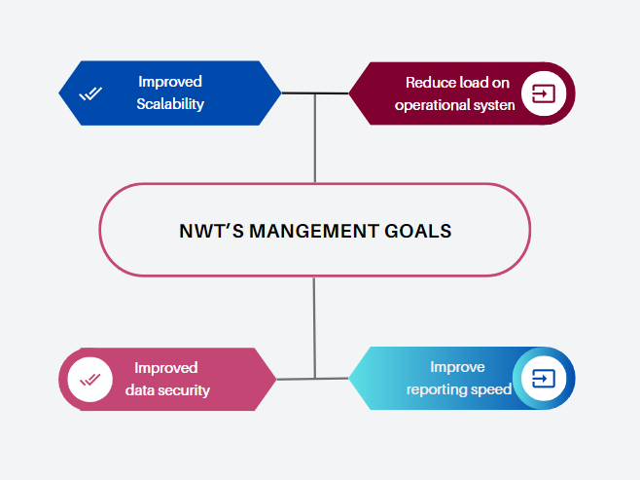
Analytics/Insights for NWT

Slide 5
Analytics/Insights for NWT
Management Goals that we are solving | Suggestions Given | How does moving it from MySQL to snowflake help achieve the Management Goals?
1) Improved Scalability | Migrate from MYSQL to Snowflake | Snowflake’s cloud based nature offers scalability
2) Improved data security |  | Snowflake’s access control mechanism
Notes:
Snowflake’s cloud based nature offers scalability,such as
Can start or stop warehouses depending on whether they are active or inactive
Allows customer to increase or decrease computing power as needed→ can scale their resources up and down without any downtime
Snowflake have a lot of different features such as end-to-end encryption for data in transit and data at rest. One of the features that we have utilized is snowflake access control mechanism. For example, one of our team mates made use it to gave us access. Such as Account Admin and sysadmin

Slide 6
Analytics/Insights for NWT
Management Goals that we are solving | Suggestions Given | How does moving it from MySQL to snowflake help achieve the Management Goals?
Reduce load on operational system | Moving from the current OLTP system to the OLAP system in snowflake | Snowflake's architecture separates compute and storage, which typically reduces the load on operational systems.
2) Improve reporting speed |  | OLAP is optimized for reporting
Notes:
OLAP is optimized for complex data analysis and reporting while OLTP is optimized for transactional processing and
real-time updates.

Slide 7
02
Project Overview

Slide 8
Pain Points
Processing Speed
Inefficient Operations
Not Scalable
Large analytical queries
Unable to meet reporting requirements
Lack of automated reports
generated by adopting OLAP (online analytical processing)
Current on premise infrastructure has limitations
Notes:
Current on premise infrastructure has limitations - because of aging hardware

Slide 9
Project Overview - Solution
Processing Speed
Things we implemented
Large analytical queries
Unable to meet reporting requirements
loading and creating tables (snowflake)
ELT Pipeline (dbt cloud)
CI/CD Pipeline (GitHub)
Reports (Linkage to Power Bi)
Notes:
loading and creating tables (snowflake)
ELT Pipeline (dbt cloud)
CI/CD Pipeline (GitHub)
Reports (Linkage to PowerBi)

Slide 10
Project Overview - Solution
Inefficient Operations
Generating reports
Lack of automated reports
generated by adopting OLAP (online analytical processing)
Created multiple dashboards that cater to the different data available to us to provide NWT with useful insights to further boost their business processes, such as Supplier, Customer, etc.
Notes:
- Dashboards: After performing all the necessary automated transformations and cleaning to our data in DBT, we will create multiple dashboards that cater to the different data available to us to provide NWT with useful insights to further boost their business processes, such as Supplier, Customer, etc.

Slide 11
Project Overview - Solution
Not Scalable
OLTP to OLAP
Current on premise infrastructure has limitations
Set up Online Analytical Processing (OLAP) system in Snowflake to better handle heavy load on operational system load

Slide 12
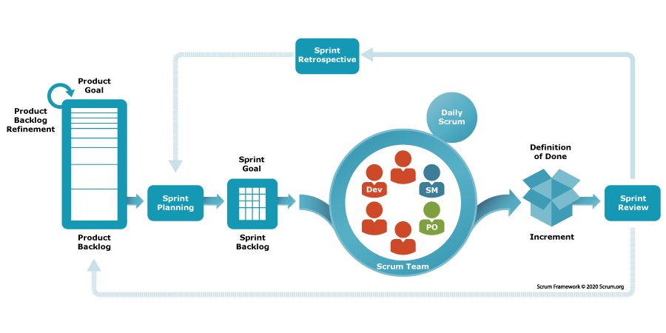
What is Scrum?
Scrum is a project management framework build under the Agile Methodology
Customer-Centric Approach with a focus on exceeding customer needs for heightened satisfaction
Scrum Artifacts to enable transparency, inspection, and adaption for effective project management
Contains 5 Events
- Sprint Planning
- Sprint
- Daily Scrum
- Sprint Retrospective
- Sprint Review
Ref: https://www.scrum.org/learning-series/what-is-scrum/
Notes:
How we gonna adapt and then further more trello to aid us in our process

Slide 13

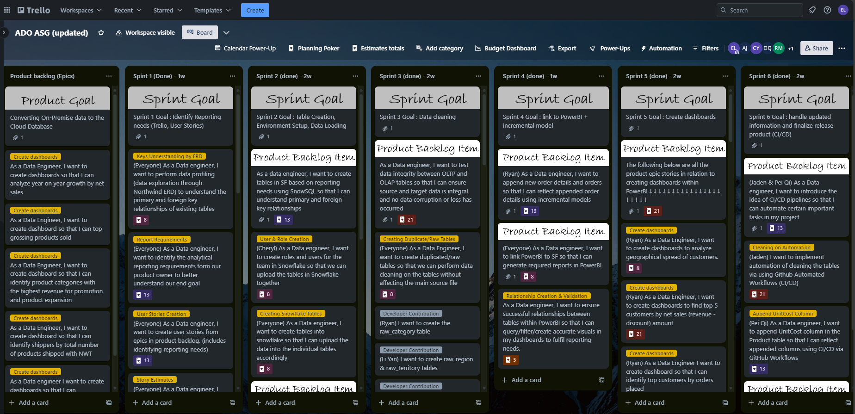
Our Trello Board
Notes:
How we gonna adapt and then further more trello to aid us in our process

Slide 14







Project Overview - Execution Timeline
Sprint 2: 2 Weeks
Sprint 4: 1 Week
Sprint 6: 2 Weeks
Setting up snowflake users and Loading Data
PowerBI Linkage and Incremental Models
CI/CD Implementation and Finalizing product release
Sprint 1: 1 Week
Sprint 3: 2 Weeks
Sprint 5: 2 Weeks
Discussions, Trello Board User Stories, Analytical Reporting Requirements
Data Testing, Data Cleaning, and Data Documentation
Visualization & Dashboard Creation
Notes:
So this is a brief overview of how the sprints will go and below we will dive deeper into what we did during each sprint.
Firstly we did sprint planning and then went on to create our 5 user stories in sprint 1
Secondly we load our data on to snowflake in sprint 2
Thirdly we clean and prepared our data in sprint 3
Fourthly we build our ETL pipeline in dbt cloud by creating an incremental in sprint 4
Next we created our Power BI dashboards in sprint 5
And lastly we build the CI/CD pipeline and finalized our product release in sprint 6

Slide 15
03
Product and Sprint Backlog + Burndown Chart
Notes:
Cheryl:edited this

Slide 16
Sprint 1 - Identify Reporting Needs
Notes:
Sprint Goal

Slide 17
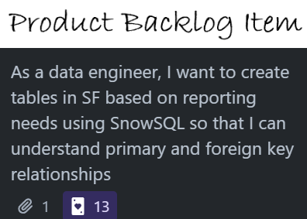
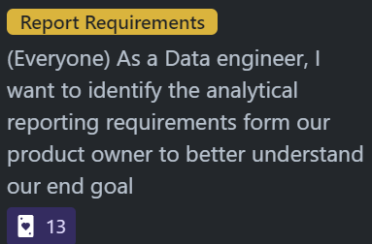
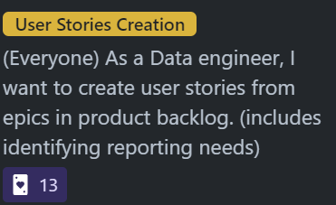
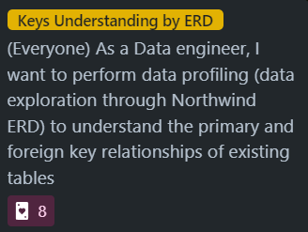
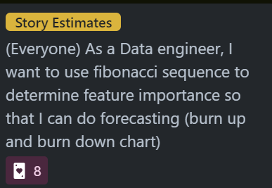
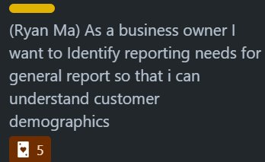
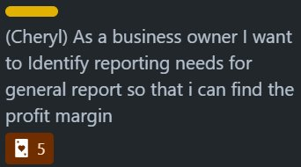
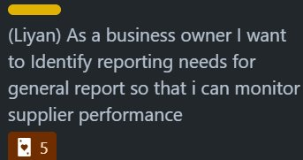
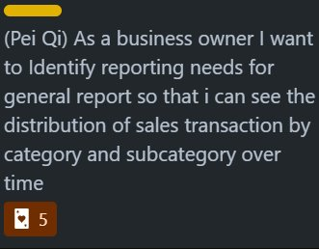
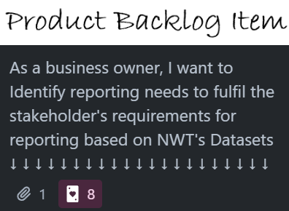
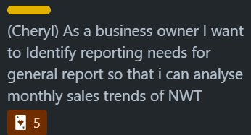

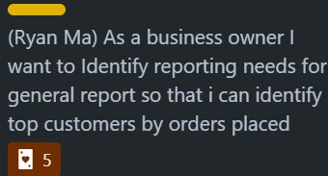
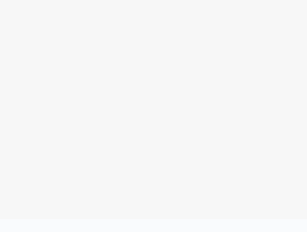
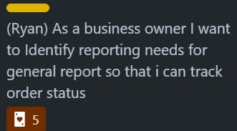
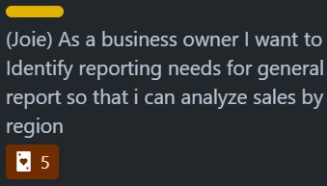
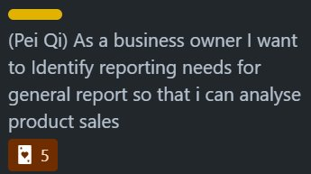
Sprint Backlog
ID | Product Backlog Item | Subtasks/Product Backlog Refinement | Points
1 |  |  | 55
2 |  |  | 68

Slide 18
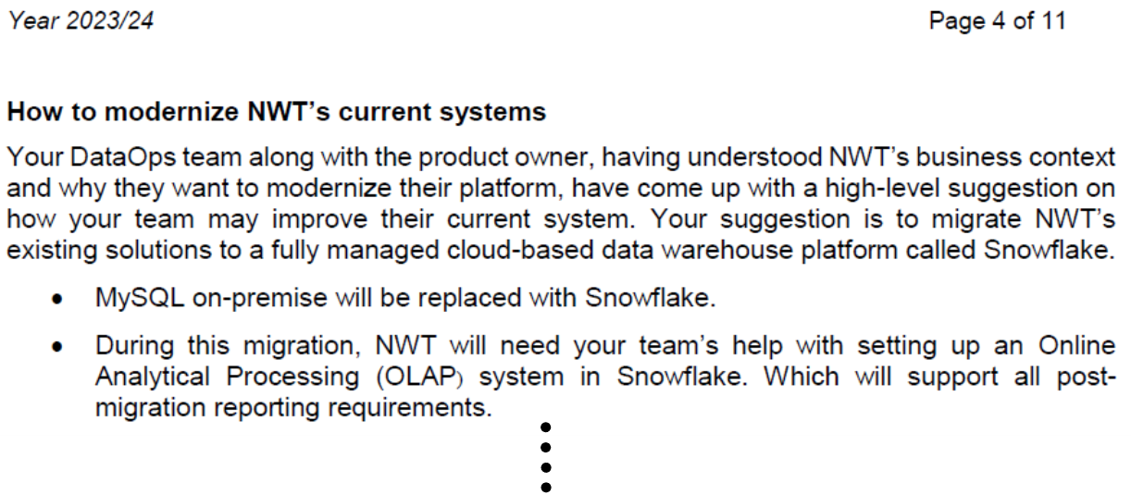
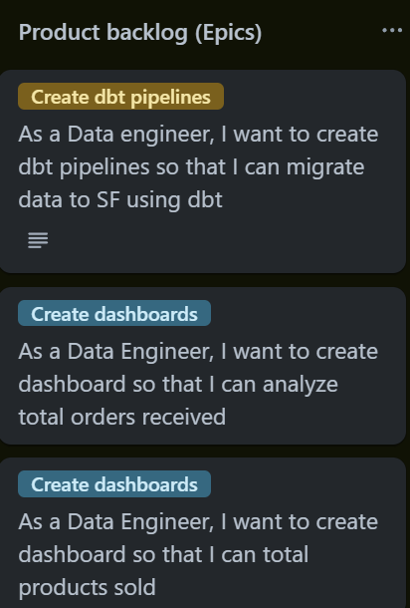
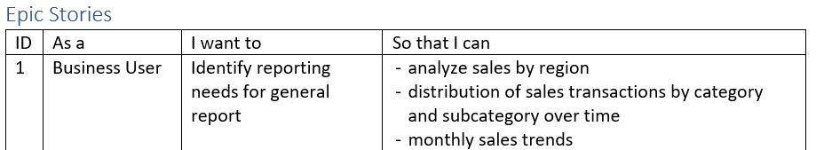
1st Product Backlog Item
Processes/Procedures of Completion | Task Accomplishments
 | ◆ Identified the Reporting Needs ◆ Cohesive Understanding of Technical Tools Used during Development ◆ Ideate and Organise the Product Development Flow ◆ Plan out Scrum Master Rotations
 | ◆ Product Owner Provided a List O f Product Backlog Items to Complete ◆ Setup of Trello Board by creating Scrum Artifacts (i.e. Sprint Backlog, Completed) ◆ Added provided user stories/ epics from the provided document

Slide 19
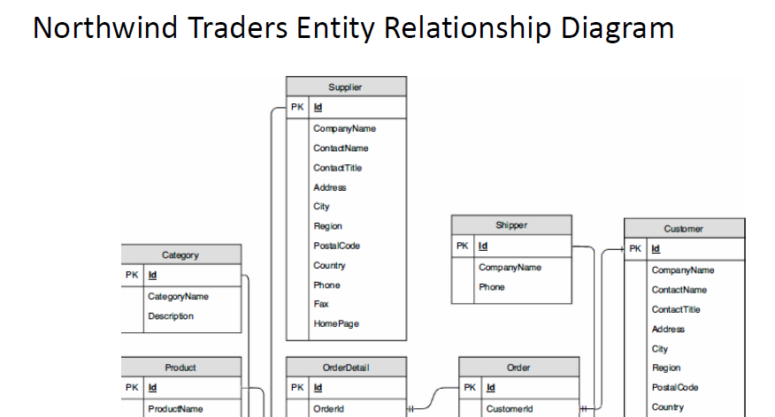
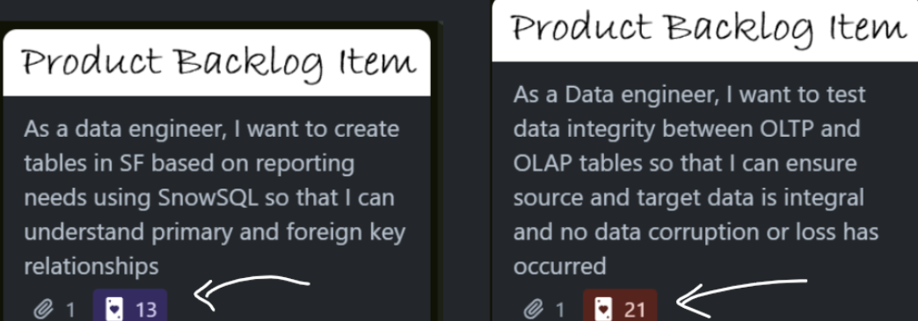
1st Product Backlog Item
Processes/Procedures of Completion | Task Accomplishments
 | ◆ Used Northwind Traders Entity Relationship Diagram to gain a better visual understanding of foreign & primary key relationships between tables ◆ However, since the task indicates table creation, this item is not entirely complete
 | ◆ After our team added all the Product backlog items, we then use ‘Poker Estimate’, adhering to the fibonacci sequence, to indicate the importance of product backlog items we will be working on during the next sprint.

Slide 20
2nd Product Backlog Item
Processes/Procedures of Completion | Task Accomplishments
 | ◆ At this final phase, our team gathered together and discussed about these items found in the product backlog. ◆ After much consideration, we have concluded that Sprint 1 was simply a baseline/ foundational Sprint to getting things started. Hence, these items could be identified as stories/suggestions to fulfil NWT’s reporting needs ◆ Furthermore, to realistically complete such items, it will have to be done in the dashboarding phase, making these stories simply ‘ideas’

Slide 21
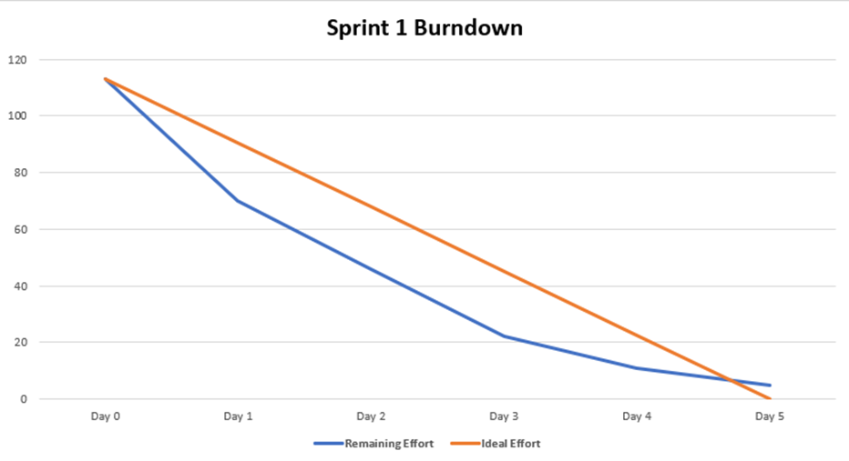
Burndown Chart for Sprint 1
Remaining Effort does not end at 0 points

Slide 22
Sprint 2 - Table & Environment Setup, Data Loading

Slide 23
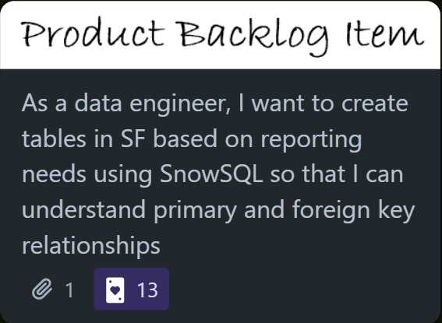
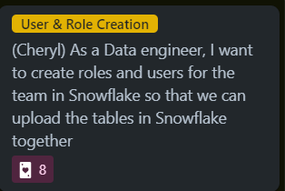
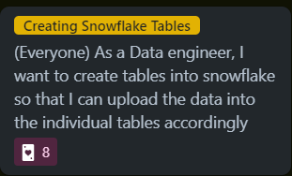
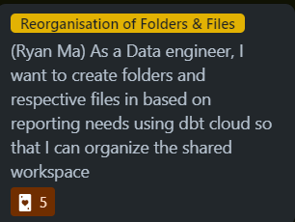
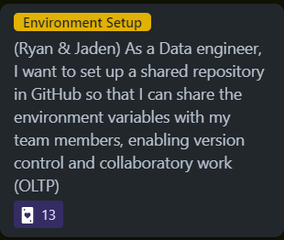
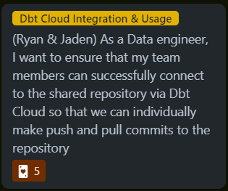
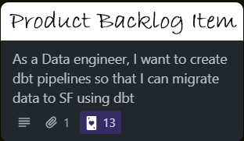
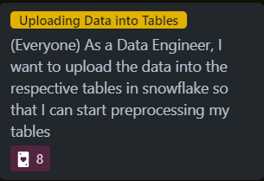
Sprint Backlog Items
ID | Product Backlog Item | Subtasks/Product Backlog Refinement | Points
1 |  |  | 21
3 |  |  | 44

Slide 24
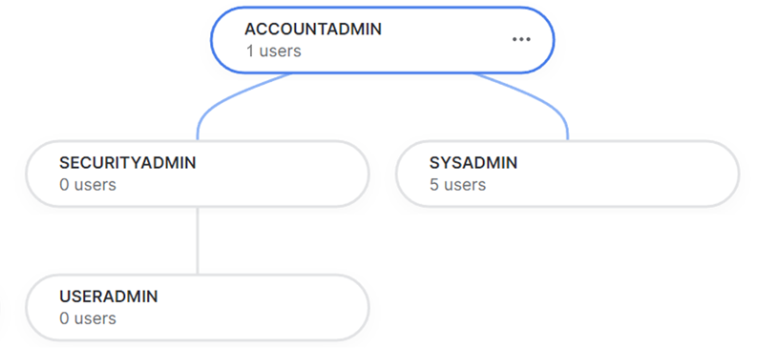
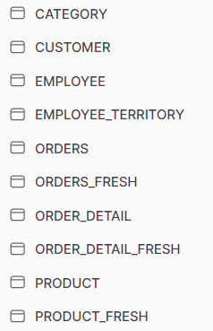
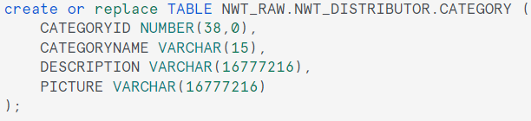
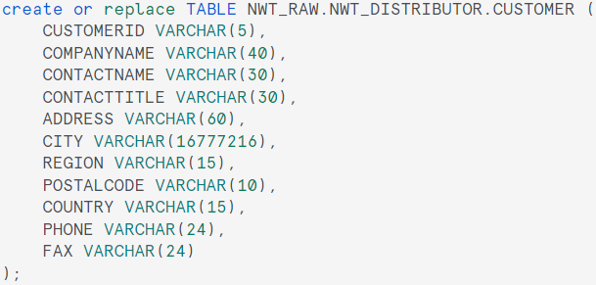
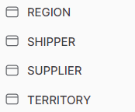
1st Product Backlog Item
Processes/Procedures of Completion | Task Accomplishments
 | ◆ Create accounts for the Scrum Team using Snowflake’s in-built user creation function ◆ SYSADMIN role provides users with the privilege of creating warehouses and databases in an account
 | ◆ Using SnowSQL to create 11 tables inside Snowflake ◆ Problem of incorrect data type to be solved with replacing the data type available (i.e. Binary -> VarChar) ◆ Tables with Problems: - Category [Picture] - Employee [ReportsTo] - Customer [City]
Notes:
Any problems?

Slide 25
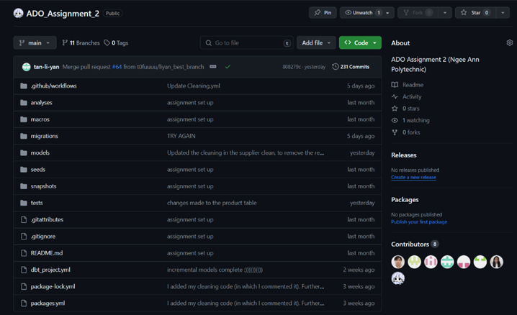
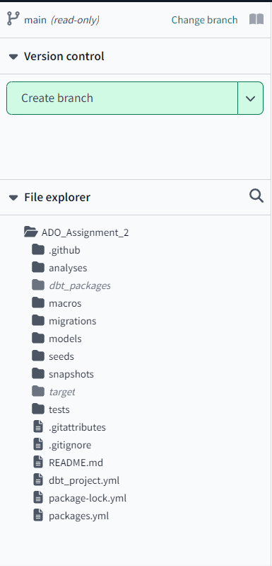
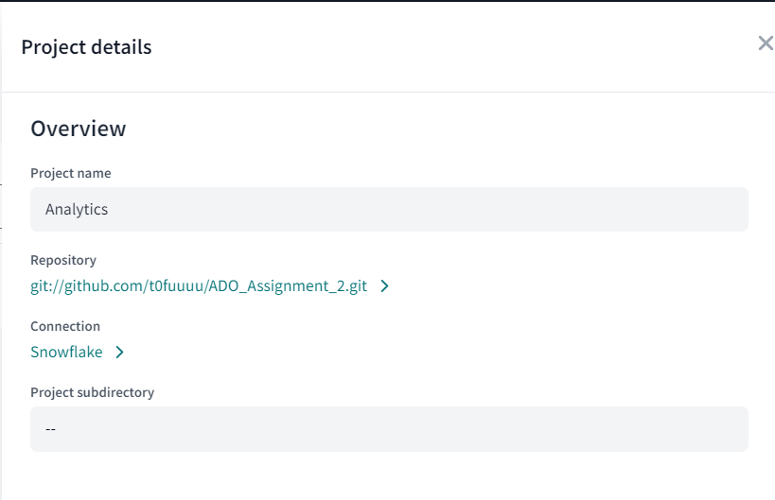
2nd Product Backlog Item
Processes/Procedures of Completion | Task Accomplishments
 | ◆ Created a Github repository for collaboration ◆ Upload all the files and folders of the dbt_snowflake environment ◆ Gave all access as collaborators to make changes to the main branch
 | ◆ Input the correct credentials for the Snowflake account and the correct Github repository in DBT Cloud ◆ Pull the data from the main branch to display all files and folders in the File Explorer ◆ Successfully commit a test file to the main branch

Slide 26
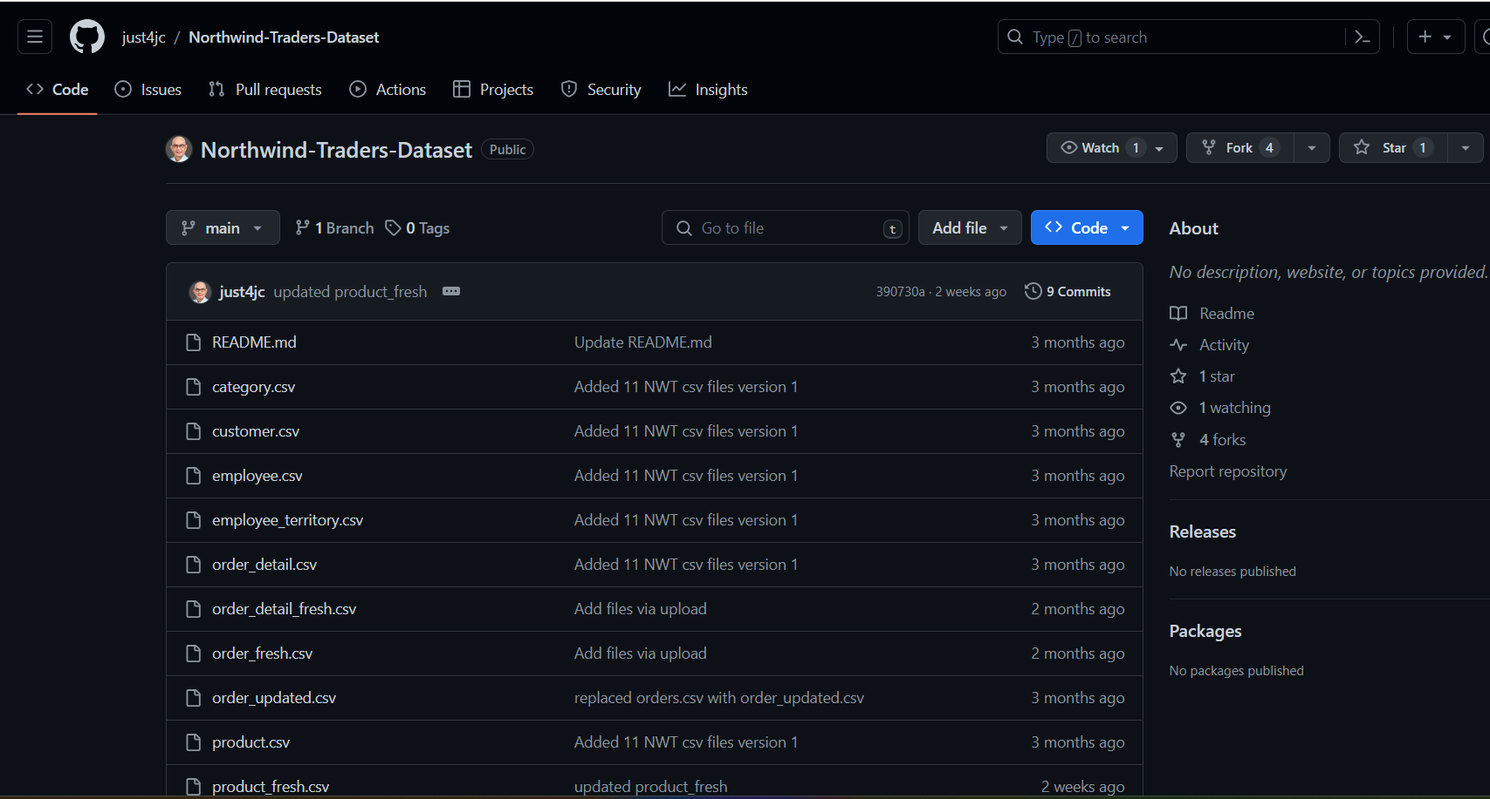
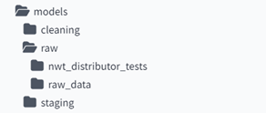
2nd Product Backlog Item
Processes/Procedures of Completion | Task Accomplishments
 | ◆ Extract the data from the Product Owner’s Github Repository ◆ Loading the 11 csv files into their respective table name in the Snowflake database
 | ◆Creating Necessary folders and files for Sprint 3 (i.e. nwt_distributor_tests for testings files & raw_data for raw files)

Slide 27
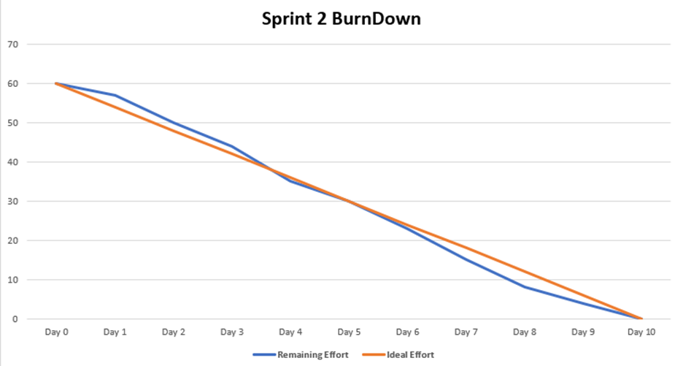
Burndown Chart for Sprint 2

Slide 28
Sprint 3 - Data Cleaning
Notes:
Sprint Goal

Slide 29
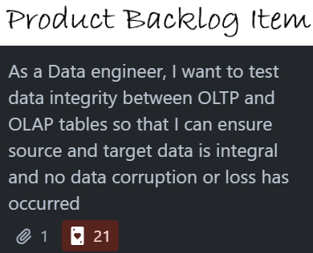
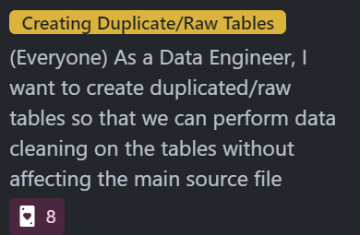
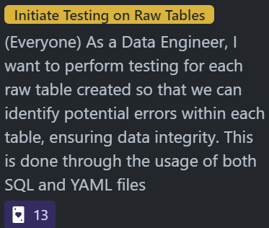
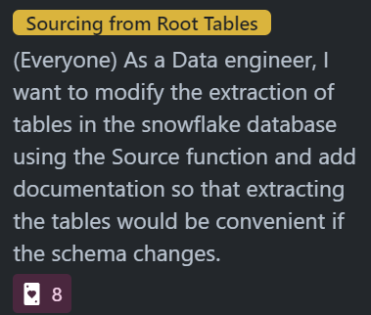
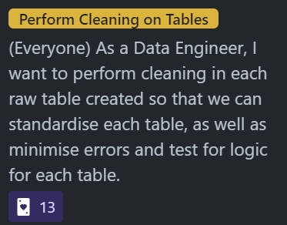
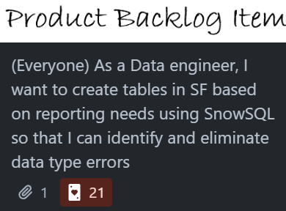
Sprint Backlog
ID | Product Backlog Item | Subtasks/Product Backlog Refinement | Points
4 |  |  | 42
5 |  |  | 42

Slide 30








1st Product Backlog Item
Processes/Procedures of Completion | Task Accomplishments
 | ◆ Created a SQL file for each table to have a “raw_tableName” for cleaning
 | ◆ Performed tests in YAML files to detect non-unique primary keys and identify null values in each column of every table ◆ Identified logical errors/inconsistent/inaccurate data from SQL testing files ◆ Brought attention to errors/problems that needs to be fixed
YAML testing files
SQL testing files

Slide 31



2nd Product Backlog Item
Processes/Procedures of Completion | Task Accomplishments
 | ◆ Used reasoning and logic to brainstorm how to fix problems identified as a group ◆ Utilised SnowSQL to perform data cleaning ◆Verified the accuracy of our data cleaning by rerunning the test SQL files, to ensure data is accurate and prepared and reliable for further use E.g. We noticed some data in the date columns were ‘0096’. We came to a consensus that ‘0096’ does not make sense because this dataset only consists of data from 1996-1998. Therefore, replaced the ‘00’ to ‘19’ instead.

Slide 32


2nd Product Backlog Item
Processes/Procedures of Completion | Task Accomplishments
 | ◆ Created a source yaml file providing descriptions and tests on uniqueness and nullability for primary/composite keys ◆Enables the appearance of lineage which allows tracking of its transformations and dependencies, ensuring data integrity and reliability
Notes:
The Source YAML file acts as a file to directly retrieve the data from the tables in Snowflake itself, sourcing from the tables itself. As mentioned previously, by using the Source YAML File, in a scenario where there are schema adjustments, instead of having to manually go to each table to change the schemas, the only change that will have to made is in the Source YAML file only, reducing the tediousness and time-consumption.
Furthermore, the Source YAML can be configured as such that descriptions and information can be included for the columns in each table. This allows documentation to be created when using the in-line command of ‘dbt docs generate’, producing automated documentation of the information of the individual tables
providing detailed descriptions on the primary/foreign keys of the tables, including the tests done on the columns such as uniqueness and nullability.

Slide 33

2nd Product Backlog Item
Processes/Procedures of Completion | Task Accomplishments
 | ◆ Creation of source yaml file allowed generation of automatic documentation when required with just 2 commands; ‘dbt docs generate’ and ‘dbt docs serve’
Notes:
May need to retake screenshot of this cuz it doesnt rlly show shit lmao and v blurry

Slide 34

Burndown Chart for Sprint 3

Slide 35
Sprint 4 - Linkage to PowerBI + Incremental Models

Slide 36




Sprint Backlog
ID | Product Backlog Item | Subtasks/Product Backlog Refinement | Points
6 |  | - | 13
7 |  |  | 13

Slide 37
Notes:
We didnt split who created which tables in snowflake and who uploaded the data ,, not sure how specific we need to be ah

Slide 38
Sprint Backlog
ID | Product Backlog Item | Subtasks/Product Backlog Refinement | Points
6 |  | - | 13
7 |  |  | 13

Slide 39

Sprint 4 - Incremental Models + Linkage to PowerBI
Our company
The introduction of your company in the pitch deck should include a brief overview of who you are and what you do. It should also include a brief description of why your product or service is unique and the value it provides to customers
Notes:
We didnt split who created which tables in snowflake and who uploaded the data ,, not sure how specific we need to be ah

Slide 40





Product Backlog Items
Processes/Procedures of Completion | Task Accomplishments
 | ◆ To append new orders and order details, we use incremental models to perform the task ◆ The incremental models checks the current highest OrderID, & then, when new order details table is uploaded, it will only append OrderIDs higher than the current maximum OrderID ◆ Applies to both Orders And Order Detail (existential logic)
 | ◆ Individually link the Snowflake data warehouse, specifying the tables we want to use, ensuring that DirectQuery is selected for real-time data streaming ◆ Each of us will then get started and create relationships in individual PowerBI ourselves
Before
After
→
→
Notes:
Explanation:
The incremental model in dbt Cloud optimizes data transformation workflows by selectively processing only the data that has changed since the last execution. Instead of reprocessing the entire dataset every time, the model intelligently identifies new or updated records based on a defined incremental update key. By focusing only on the delta changes, the incremental model significantly reduces processing time and resource consumption, leading to faster and more efficient data transformations.
Key Points to Highlight:
Efficiency: The incremental model improves efficiency by avoiding redundant processing of unchanged data, resulting in faster execution times and reduced resource usage.
Scalability: As datasets grow larger, incremental processing becomes increasingly important for maintaining manageable processing times and meeting performance requirements.
Data Consistency: By consistently updating data with only the latest changes, the incremental model ensures that downstream analytics and reporting are always based on the most up-to-date information.
Automation: With dbt Cloud's scheduling capabilities, the incremental model can be automated to run at regular intervals, providing timely updates to data transformations without manual intervention.

Slide 41

Burndown Chart for Sprint 4

Slide 42
Sprint 5 - Creating Dashboards

Slide 43










Sprint Backlog Items
ID | Product Backlog Item | Subtasks/Product Backlog Refinement
8
………….

Slide 44

Burndown Chart for Sprint 5

Slide 45
Sprint 6 - CI/CD Pipeline + Finalizing Product Release

Slide 46




Sprint Backlog Items
ID | Product Backlog Item | Subtasks/Product Backlog Refinement | Points
1 |  |  | 47
2 |  | - | 13

Slide 47



1st Product Backlog Item
Processes/Procedures of Completion | Task Accomplishments
 | ◆ Made Github repository secrets to store credentials of Snowflake Account (Security Measure) ◆ Created ‘product.yml’ in Github Action Workflow to automate the process of appending UnitCost from Product Fresh ◆ Writing the SQL code to add the UnitCost column and incremental modelling ◆ The workflow action is able to run successfully ◆ Check whether the UnitCost column is appended to the Product table

Slide 48




1st Product Backlog Item
Processes/Procedures of Completion | Task Accomplishments
 | ◆ Created a ‘Cleaning.yml’ in Github Action Workflow to automate the process of cleaning the tables after each push/merge to the main branch ◆ Rename the beginning of all cleaning files to ‘A__’ to continuously run the cleaning files despite no changes being made to it ◆ Commit and sync the changes and see the Cleaning workflow run in Github Actions ◆ Github Workflow runs successfully with it applying to changes to all cleaning scripts ◆ The cleaning files are able to clean the tables successfully in Snowflake

Slide 49


2nd Product Backlog Item
Processes/Procedures of Completion | Task Accomplishments
 | ◆ Reviewed initial requirements for the data migration project to ensure all expectations are met and understood ◆Documented data migration process, including ELT pipeline ◆Defined user roles and access permissions in Snowflake to ensure data privacy and compliance with regulations.

Slide 50

Burndown Chart for Sprint 6

Slide 51

Video of ELT Pipeline

Slide 52

Total Consumption

Slide 53
04
Last Sprint Retrospective

Slide 54

Last Sprint Retrospective
As described in the Scrum Guide, the purpose of the Sprint Retrospective is to plan ways to increase quality and effectiveness.
Glad/Kudos​
Completed project despite obstacles on time​
Automated cleaning​
Sad
Project is over
Mad​
Lack of detailed documentation​
Long confusion on CI/CD Pipeline implementation​
Notes:
As described in the Scrum Guide, the purpose of the Sprint Retrospective is to plan ways to increase quality and effectiveness.
Sprint:
Our feelings towards this project overall (reference to reflection?)
Identify things that led us astray (what problems)
What went well
How problems were solved/not solved
What can be improved

Slide 55

Last Sprint Retrospective

Slide 56
Conclusion
Manage to successfully migrate to cloud
Utilized CI/CD pipeline to automate
Successfully met NWT reporting requirements
by implementing dashboards related to user stories

Slide 57
05
Individual Presentation

Slide 58

Jaden Ang

Slide 59

Supplier Dashboard
Purpose:
Monitor NWT Employee’s performance throughout the years
Allow NWT to potentially reward top performing employees, as well as identify areas of organizational improvements

Slide 60







User Stories

Slide 61


User Story 1

Slide 62

User Story 2

Slide 63

User Story 3

Slide 64

User Story 4

Slide 65


User Story 5

Slide 66

Ryan Ma

Slide 67







Creation of ELT Pipeline
Sprint 1 - Identifying Reporting Needs
Team Effort
Individual Contribution
Our company
The introduction of your company in the pitch deck should include a brief overview of who you are and what you do. It should also include a brief description of why your product or service is unique and the value it provides to customers
Notes:
Do we include product backlog again omg

Slide 68





Creation of ELT Pipeline
Sprint 2 - Table creation, Environment Setup, Data Loading (ELT)
Team Effort
Individual Contribution
Our company
The introduction of your company in the pitch deck should include a brief overview of who you are and what you do. It should also include a brief description of why your product or service is unique and the value it provides to customers
Notes:
We didnt split who created which tables in snowflake and who uploaded the data ,, not sure how specific we need to be ah

Slide 69




Creation of ELT Pipeline
Sprint 3 - Data Cleaning (ELT)
Team Effort
Our company
The introduction of your company in the pitch deck should include a brief overview of who you are and what you do. It should also include a brief description of why your product or service is unique and the value it provides to customers
Notes:
We didnt split who created which tables in snowflake and who uploaded the data ,, not sure how specific we need to be ah

Slide 70


Creation of ELT Pipeline
Sprint 4 - Incremental Models + Linkage to PowerBI
Team Effort
Individual Contribution
Our company
The introduction of your company in the pitch deck should include a brief overview of who you are and what you do. It should also include a brief description of why your product or service is unique and the value it provides to customers
Notes:
We didnt split who created which tables in snowflake and who uploaded the data ,, not sure how specific we need to be ah

Slide 71

Creation of ELT Pipeline
Sprint 4 - Incremental Models + Linkage to PowerBI
Our company
The introduction of your company in the pitch deck should include a brief overview of who you are and what you do. It should also include a brief description of why your product or service is unique and the value it provides to customers
Notes:
We didnt split who created which tables in snowflake and who uploaded the data ,, not sure how specific we need to be ah

Slide 72








Creation of ELT Pipeline
Sprint 5 - Creating Visuals + Dashboard
Our company
The introduction of your company in the pitch deck should include a brief overview of who you are and what you do. It should also include a brief description of why your product or service is unique and the value it provides to customers
Notes:
We didnt split who created which tables in snowflake and who uploaded the data ,, not sure how specific we need to be ah

Slide 73

Customer Dashboard
Purpose
Provides in-depth analysis on NWT’s Customers, identifying underlying trends & gaining a deeper understanding of customers
Enable NWT to provide better customer support
Allow NWT to tactfully plan out resources for top customers, maximising sale gains

Slide 74

Customer Dashboard

Slide 75

Customer Dashboard

Slide 76

Customer Dashboard

Slide 77



Customer Dashboard

Slide 78

Customer Dashboard

Slide 79

Cheryl Neo
Notes:
gorgeous

Slide 80

ELT Pipeline
Sprint 1 - Identifying Reporting Needs
Notes:
Do we include product backlog again omg

Slide 81



ELT Pipeline
Sprint 2 - Table creation, Environment Setup, Data Loading (ELT)
Although Ryan was the one that created the roles for the rest of us (since he is the ACCOUNTADMIN), I did the research on how to create users and guided him how to do it

Slide 82




ELT Pipeline (How it was created)
Sprint 3 - Data Cleaning (ELT)
I did the raw_category YAML and raw_customer SQL testing files
Ryan did raw_customer and raw_employee_territory YAML

Slide 83


ELT Pipeline (How it was created)
Sprint 3 - Data Cleaning (ELT)
Source YAML file

Slide 84


ELT Pipeline (How it was created)
Sprint 4 - Linkage to PowerBI
Our company
The introduction of your company in the pitch deck should include a brief overview of who you are and what you do. It should also include a brief description of why your product or service is unique and the value it provides to customers
Linked with Direct Query so that live and updated data can be retrieved automatically

Slide 85


ELT Pipeline (How it was created)
Sprint 5 - Create Dashboards
New table
Our company
Created new columns and measures in order to make visuals for my dashboards
The introduction of your company in the pitch deck should include a brief overview of who you are and what you do. It should also include a brief description of why your product or service is unique and the value it provides to customers

Slide 86

ELT Pipeline (How it was created)
Sprint 5 - Create Dashboards
Snowflake Schema Created:
Category
Product
Orders
Customer
Order Detail
Calendar (created)
Our company
The introduction of your company in the pitch deck should include a brief overview of who you are and what you do. It should also include a brief description of why your product or service is unique and the value it provides to customers

Slide 87

Sales Overview Dashboard
Purpose:
Allows NWT to identify interesting points and helps highlight problems and opportunities for improvement
Provides insights into sales performance and trends for informed decision-making

Slide 88








User Stories

Slide 89

User Stories

Slide 90


User Stories

Slide 91

User Stories

Slide 92


User Stories

Slide 93

Tan Li Yan
Notes:
charming

Slide 94

Supplier Dashboard
Purpose:
Identify, track and optimize all processes between the supplier & NWT
Allow NWT to potentially broker better deals with suppliers.

Slide 95

User stories

Slide 96


User story 1
Notes:
Higher customer purchase volumes from these suppliers allow NWT to buy more products, creating an opportunity to request bulk discounts

Slide 97


User story 2

Slide 98


User story 3

Slide 99



User story 4

Slide 100


User story 5

Slide 101

Supplier Drill Through

Slide 102

Joie Lim
Notes:
hottie

Slide 103
Creation of ELT Pipeline
Throughout the sprints
Raw Tables
Staging Files
Customer
Order
Order detail
Region
Product
Category
Employee
Employee territory
Employee region
Shipper
Supplier
stg customer
stg order
stg order detail
stg product
stg category
Individual Dashboard
Our company
Sales by region
Top 10 products by profit
Sales over the years (revenue, net sales)
The introduction of your company in the pitch deck should include a brief overview of who you are and what you do. It should also include a brief description of why your product or service is unique and the value it provides to customers
Notes:
Do we include product backlog again omg

Slide 104
Creation of ELT Pipeline
Sprint 4 - Incremental Models + Linkage to PowerBI
Our company
The introduction of your company in the pitch deck should include a brief overview of who you are and what you do. It should also include a brief description of why your product or service is unique and the value it provides to customers
Notes:
We didnt split who created which tables in snowflake and who uploaded the data ,, not sure how specific we need to be ah

Slide 105






User Stories

Slide 106

Dashboard
Purpose
What is the profitability of each region/country?
Where should I expand/put more money in to marketing? What is the revenue and sales?
When am I most profitable
(by country/products)?

Slide 107
Dashboard
Funnel Chart
Easily identify the revenue, net sales, profit and profit margin
Pie Chart
Top 10 most profitable products (can be filtered down to a region/country
Most profitable product : Cole de Blaye
Bar Chart
Profit by each region/country
Identify most/least profitable country
Compare companies performance across various countries

Slide 108
Dashboard
Line and Bar Chart
Easily identify the trend of revenue, net sales and quantity
Answers the question of when
(e.g. when the country/product is doing well)
Map
Total revenue by country
Easily identify NWT markets
Answers the question of where (e.g where is NWT revenue coming from)

Slide 109

Dashboard - Filtered to a Product

Slide 110

Dashboard - Filtered to a Country

Slide 111

Drill Through Dashboard - USA

Slide 112

Drill Through Dashboard - USA

Slide 113

Drill Through Dashboard - USA

Slide 114

Pei Qi
Notes:
bootiful

Slide 115

Product Sales Analysis Dashboard
Purpose:
Identify the sales of product and the category
Allow NWT to understand what can possibly be continued ad discounted

Slide 116






User Stories

Slide 117

User Story 1

Slide 118

User Story 2

Slide 119

User Story 3

Slide 120

User Story 4

Slide 121

User Story 5

Slide 122

Drill Through Dashboard

Slide 123
Links1 1
●Scrum Board:
https://trello.com/b/hAGYg0TB/ado-asg-updated
●User credentials to Snowflake:
http://tinyurl.com/bdh8bcd6
Username: RyanADO
Password: T0516913a7239973j
●Github Repository:
https://github.com/t0fuuuu/ADO_Assignment_2

Slide 124
Thank You!

